Slide 1
Coursework on the topic: «Farm Information System»
Created by a student of group КС-20
Царенком Р.М.
Head: senior lecturer
Гребенович Ю.Є.

Slide 2
Phases
1
Subject area analysis
2
Database design
3
Client application view

Slide 3
Phase 1. Subject area analysis:
First of all, to set tasks for the course work, choose the software and technologies that will be applied, you need to analyze the subject area, find out what are the pros and cons.
When I started looking for the material, I realized that they are not very available in the public domain.
In general, farms use Excel tables, or order programmable Excel tables. Large farms use 1C, or order specialized programs written for themselves, which makes it difficult to access and analyze them.

Slide 4
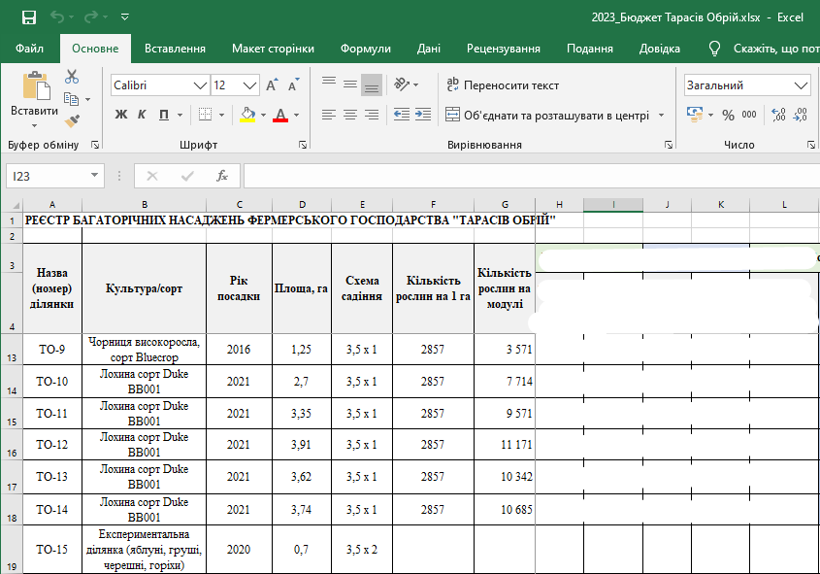
Phase 1. Subject area analysis:
But one farm, provided an Excel version of the table and the data they process.

Slide 5
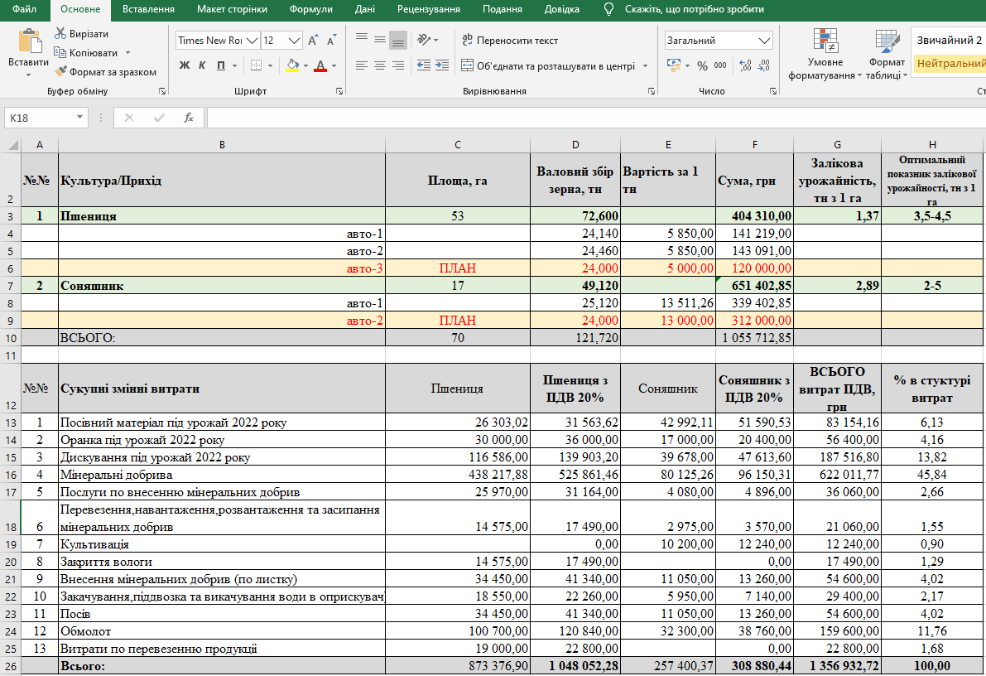
Phase 1. Subject area analysis:
After analyzing the table, it became clear what data to work with and store. What software is suitable for development.

Slide 6


Phase 1. Subject area analysis:
So, as for the database, I came to the conclusion that the following main entities (tables) are needed for the future database:
1. Animals. You need to control their number, their placement, consumption, gender, type of animal.
2. Plantings. You need to control the number, if possible, of planting, or specify the area if it is a grain crop, the date of planting, and the name of planting.

Slide 7
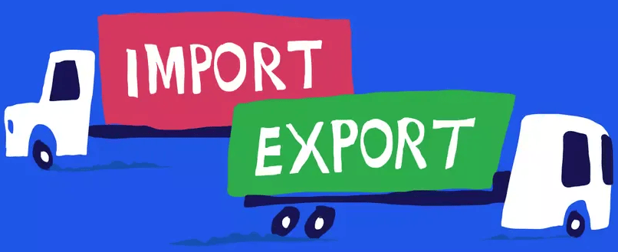
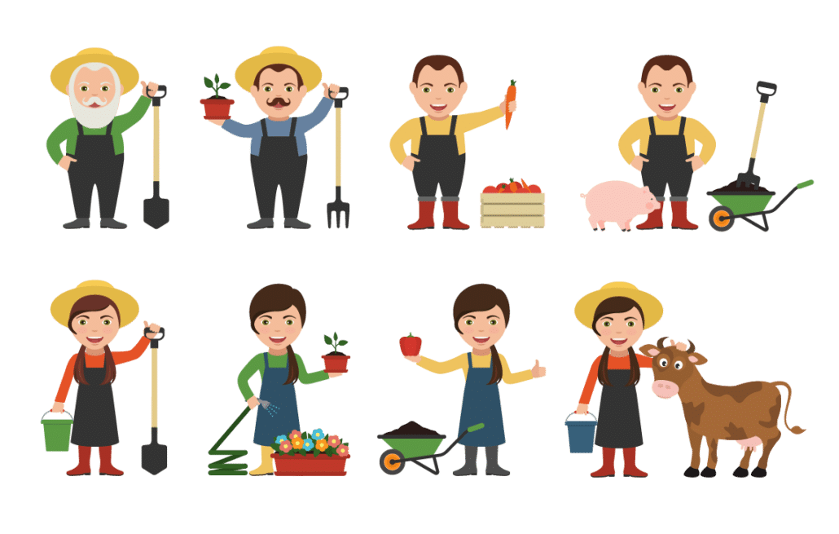
Phase 1. Subject area analysis:
3. Export. General statistics, with dates, quantity, prices, product names, and where to go.
4. Import. Almost everything is the same, only from where it was imported.
5. Employees. Where they work, what profession, full name, phone number, residential address.
And of course, also additional entities (tables) that will accompany the main entities.

Slide 8



Phase 1. Subject area analysis:
In technical terms, SQLite was chosen because farms usually need an automated system that does not require the internet and server settings. And for writing a client application, the C# programming language and the WPF framework were selected.

Slide 9
Phase 2. Database design:
After analyzing the subject area, you can understand that the task is divided into 2 parts. This includes designing a database and writing a client application. First, a superficial analysis was carried out, then an in-depth one, which identified additional entities (tables), fields of all tables where data will be stored, and the result was the creation of an infographic model that reflects all this:

Slide 10
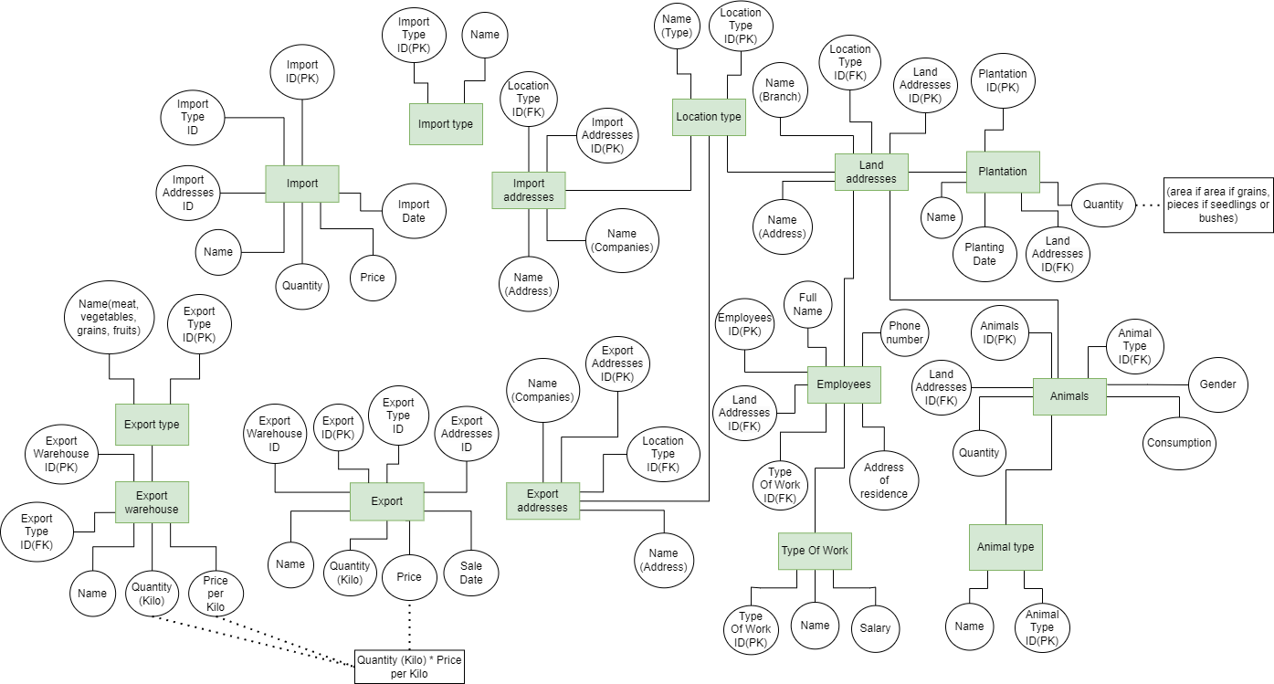
Phase 2. Database design:
Infographic model or ER diagram

Slide 11
Phase 2. Database design:
The next step was to expand the diagram from a technical point of view, and determine the data types that fit the corresponding fields, and we will get a data logical model that will help us create the correct database.

Slide 12
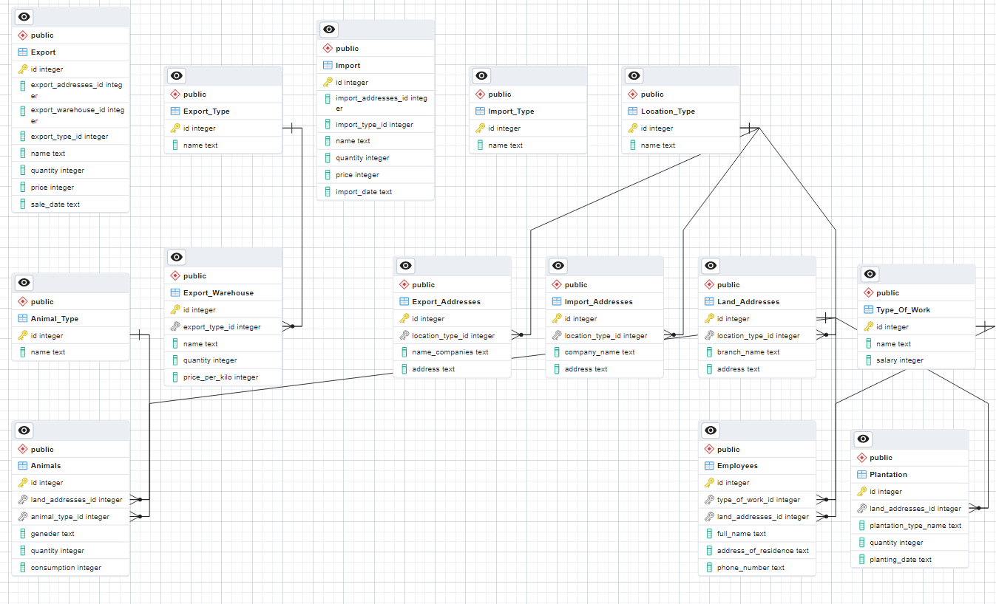

Slide 13
Phase 3. Client application view:
Well, the final stage is the development of a client application. During the analysis of the subject area, it was touched upon that it will be possible to separate accounting tables that are directly related to the farm itself, namely, accounting for animals, farm land, employees, and others that were specified earlier. And separately related to export/ import, and this was confirmed when the diagrams were created and the database was created.

Slide 14
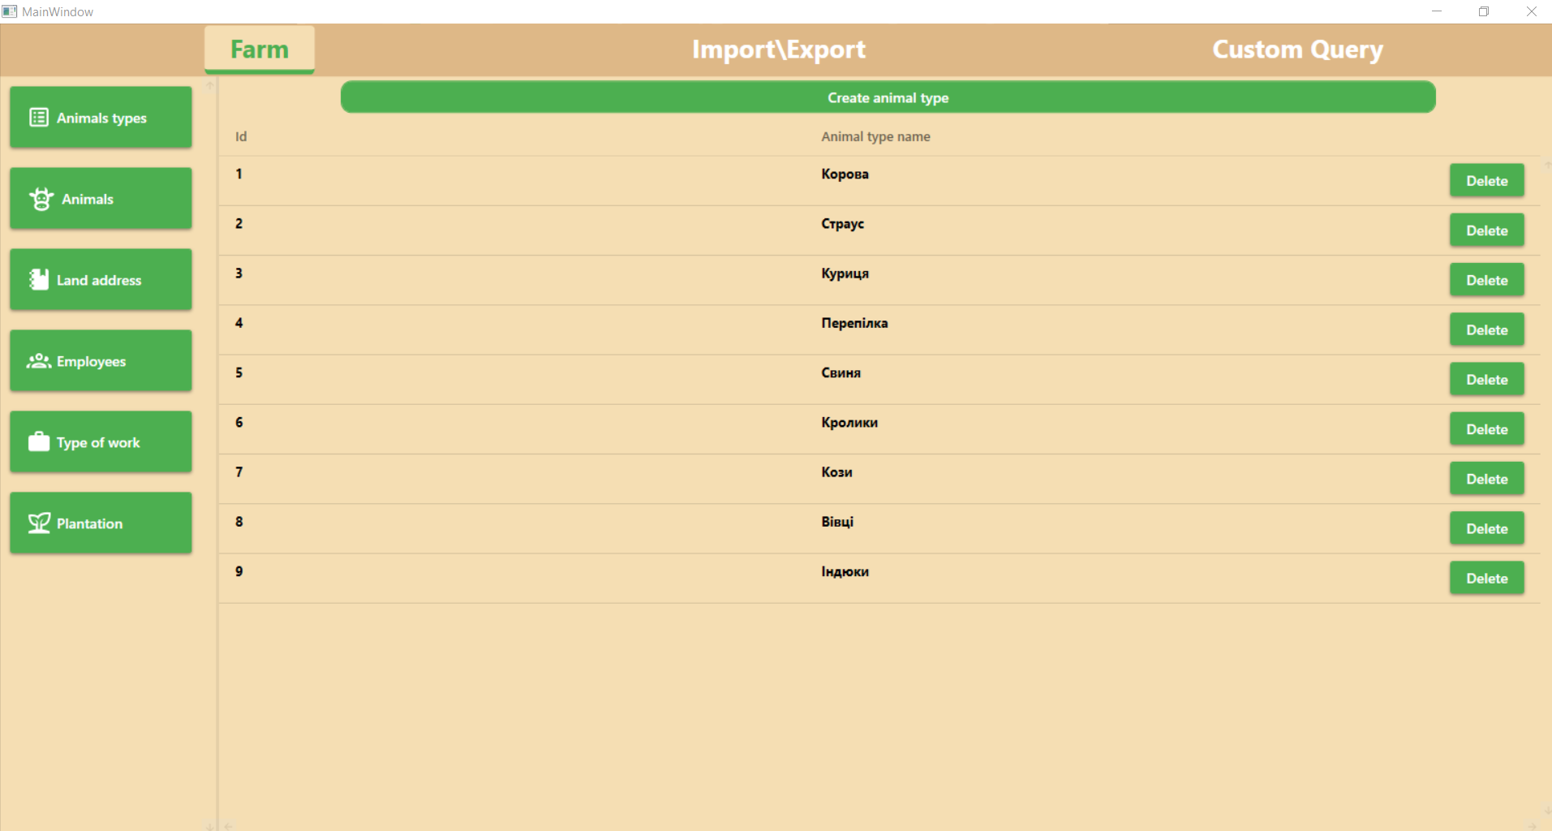
Phase 3. Client application view:
And that is why the client application looks like this: 3 tabs, a sidebar with tables, a field where table data is displayed, a buttons for adding and deleting a record

Slide 15
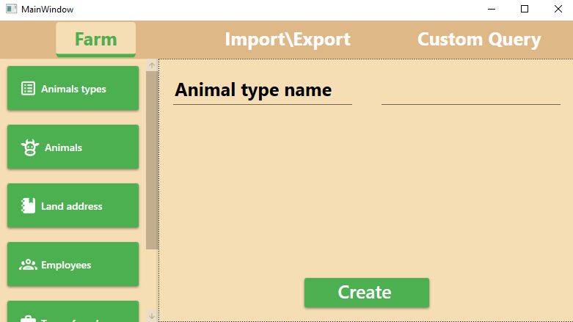
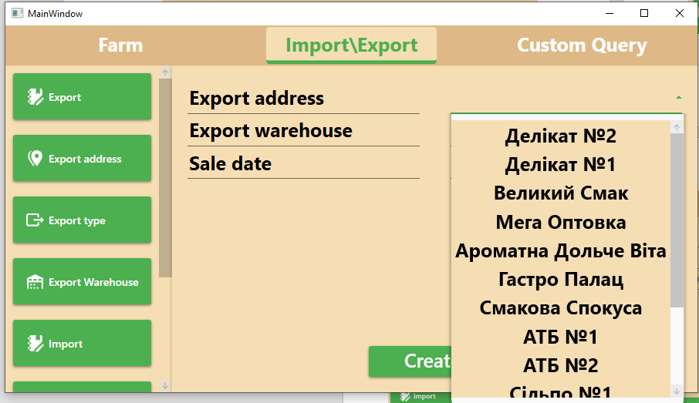
Phase 3. Client application view:
And this is what the pages of adding a record look like:

Slide 16
That's all, thank you for your attention.

